Slide 1
Conjecture and Proof
Converse, Inverse and Contrapositive Statements. Proof by Contradiction and the Pigeon-Hole Principle.

Slide 2
Proof by Contradiction
When proving a statement by contradiction, your proof must start with the assumption that the opposite case of the statement is true.
For example, proof that: You cannot have a right triangle with one side of length 3x cm, another side of length (4x + 5) cm and the longest side of length (5x + 4) cm.
The proof : show that the opposite of the statement is true
Note that by starting with the opposite statement, our proof will end up with a contradiction in the last step, which will prove the original statement is false.
Assume that these side lengths give a right angled triangle. If so, then by Pythagoras’ Theorem, the square of the two shorter sides will equal the square of the longer side.
LHS: (3x)² + (4x + 5)² = 25x² + 40x + 25
RHS: (5x + 4)² = 25x² + 40x + 16
Since the LHS ≠ RHS, this contradicts our initial assumption. Hence these side lengths do not make a right angled triangle.

Slide 3
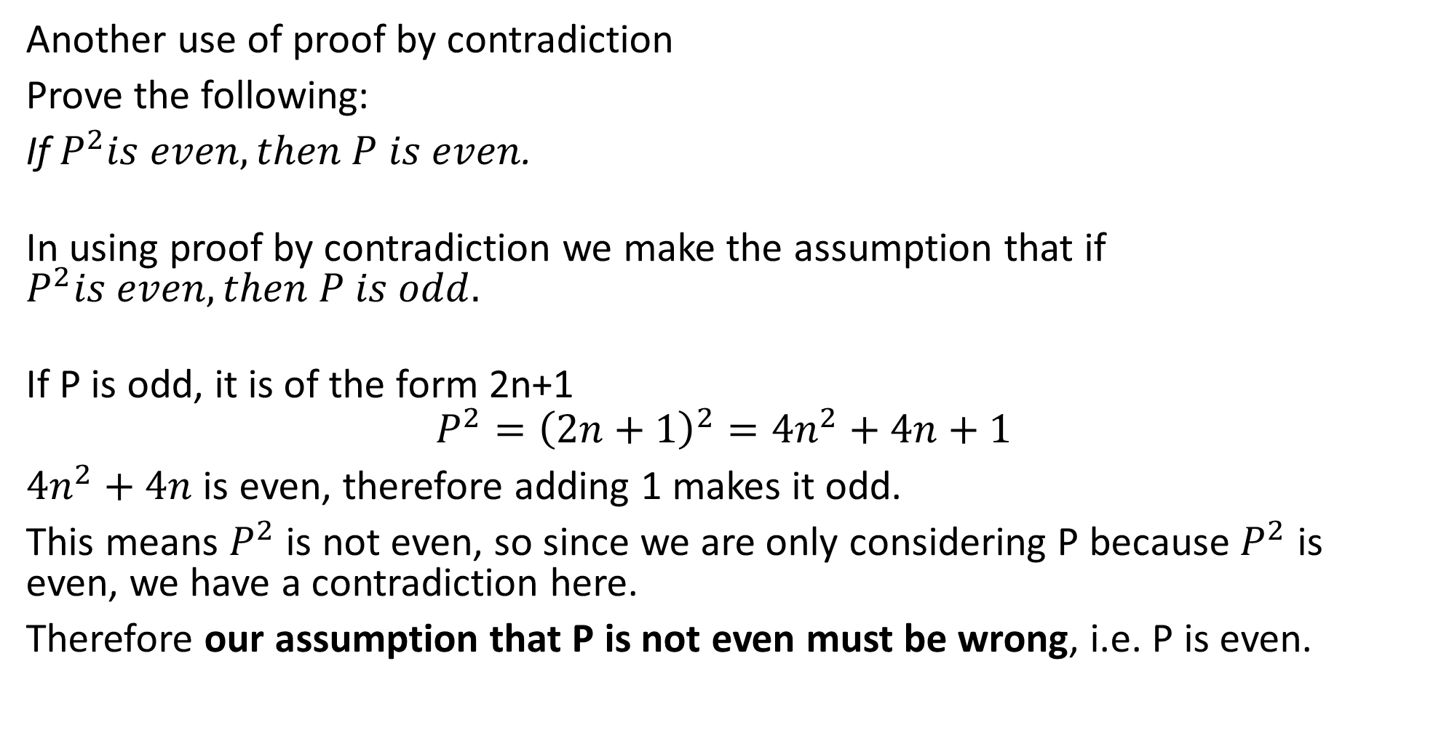
Concept Development: Contradiction
Another use of proof by contradiction
Prove the following:
If $P^{2}is even, then P is even$.
In using proof by contradiction we make the assumption that if $P^{2}is even, then P is odd.$
If P is odd, it is of the form 2n+1
$$P^{2}={\left(2n+1\right)}^{2}=4n^{2}+4n+1$$
$4n^{2}+4n$ is even, therefore adding 1 makes it odd.
This means $P^{2}$ is not even, so since we are only considering P because $P^{2}$ is even, we have a contradiction here.
Therefore our assumption that P is not even must be wrong, i.e. P is even.

Slide 4

Cambridge Ex 6C Example 12
An angle is called Reflex if it exceeds $180°$.
Prove that no quadrilateral has more than one reflex angle.

Slide 5
Cambridge Ex 6C Q1

Slide 6
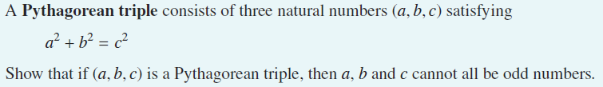
Cambridge Ex 6C Example 13

Slide 7
Cambridge Ex 6C: Irrational Number
Proof: $\sqrt{2}$ is irrational

Slide 8

Cambridge Ex 6C Example 14
Suppose $x$ satisfies $5^{x}=2$ . Show that $x$ is irrational

Slide 9
Cambridge Ex 6C Q2

Slide 10
Cambridge Ex 6C Q3

Slide 11
Cambridge Ex 6C Q7

Slide 12

Cambridge Ex 6C Q10

Slide 13
INVERSE Statements
The inverse of ‘If P then Q’ is ‘If not P then not Q’.
For example, if we have the statement:
If x = 2, then x² = 4
The inverse is:
If x ≠ 2, then x² ≠ 4
If you want to write the inverse statement, the events P and Q are left in the same position but they are negated.
We can see that the inverse of a true statement is NOT ALWAYS TRUE. The example above has an exception: if x = -2, then x² = 4 and for this case x ≠ 2 but x² = 4.

Slide 14

EXAMPLE 2: Inverse (NEGATE IT)
For each statement below, find its inverse and decide whether or not it is true.
If an animal is a koala, then it lives in a tree.
If $x≥3$, then $x^{2}≥9$
INVERSE: If an animal is not a koala, then it does not live in a tree.
FALSE, because birds are not koalas but they live in trees.
INVERSE: If $x<3$ then $x^{2}<9$
FALSE, because $−4<3$ but $(−4)^{2}=16$ and $16>9$

Slide 15
Independent Practice
Cambridge Ex 6C
Exclude Q5
Extra worksheet: Proofs – WS 1

